Slide 1






ROCKBUSTER STEALTH LLC.
A movie rental company to launch online video rentals

Slide 2

Objective To determining which movies and regions have the highest revenue for the 2020 Rockbuster strategy. Thus, defining use of existing movie license to launch an online video rental service to remain competitive with streaming services such as Netflix and Amazon Prime. Project Brief
Data
Skills and Tools
Rockbuster Stealth LLC movie rental data managed by PostgreSQL.
Visualization data can be viewed with Tableau.
Relational databases SQL Database querying Filtering
Cleaning and summarizing Joining tables Subqueries Common table expressions
GitHub - SQL Analysisv
Constraints:
Historical records are of games which sold greater than 100,000 units, to the end of 2016.
Figures are in total number of units sold (in millions), not financial figures.
Competitor data was not available for analysis to establish companies standing in the market.
Files link
ROCKBUSTER STEALTH PROJECT

Slide 3
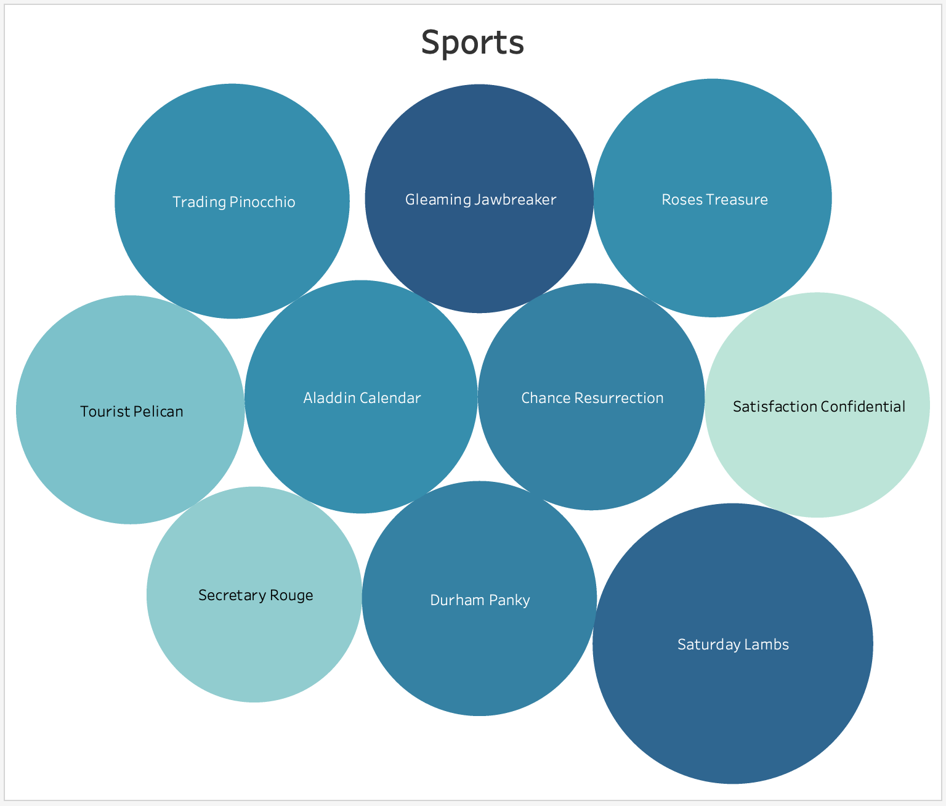
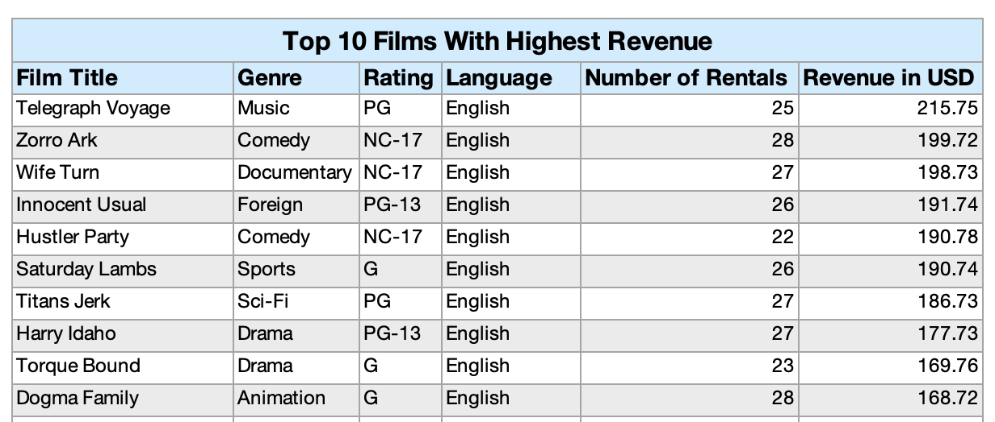
Rockbuster’s Video Rental Market: Countries Distribution: 109 Titles: 1000 Customers: 599 Total Revenue: $61312.04
ANALYSIS
Uppermost Genre in Revenue
Sports
Sci-Fi
Animation
ROCKBUSTER STEALTH PROJECT

Slide 4
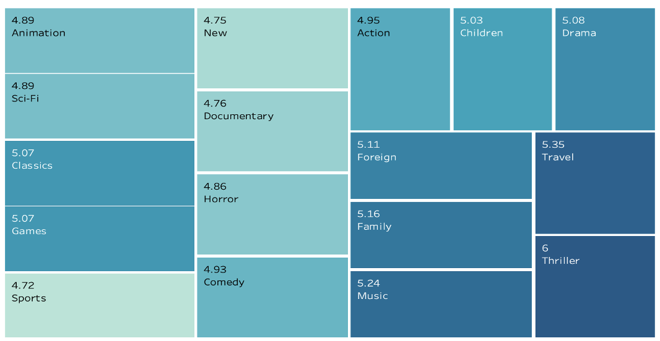
Number of Rentals by Genre G - 2,508, profiting $10,512 NC - 3,008, profiting $12,635 PG - 2,938, profiting $12,237 PG-13 - 3,245, profiting $13,856 R - 2,987, profiting $12,073
ANALYSIS
Average Duration of Rental (Days) - Genre
Duration of Rental (Days) - Rating
Rating | Avg. Rental Length | Minimum Rental | Maximum Rental
G | 4.84 | 3 | 7
PG | 5.08 | 3 | 7
PG-13 | 5.05 | 3 | 7
R | 4.77 | 3 | 7
NC-17 | 5.14 | 3 | 7
Average Rental Duration: 5 Days
Minimum/Maximum Rental Rate: $0.99/$4.99
Average Rental Rate: $2.998
Minimum/Maximum Replacement Cost: $9.99/$29.99
Average Replacement Cost: $19.98
ROCKBUSTER STEALTH PROJECT

Slide 5
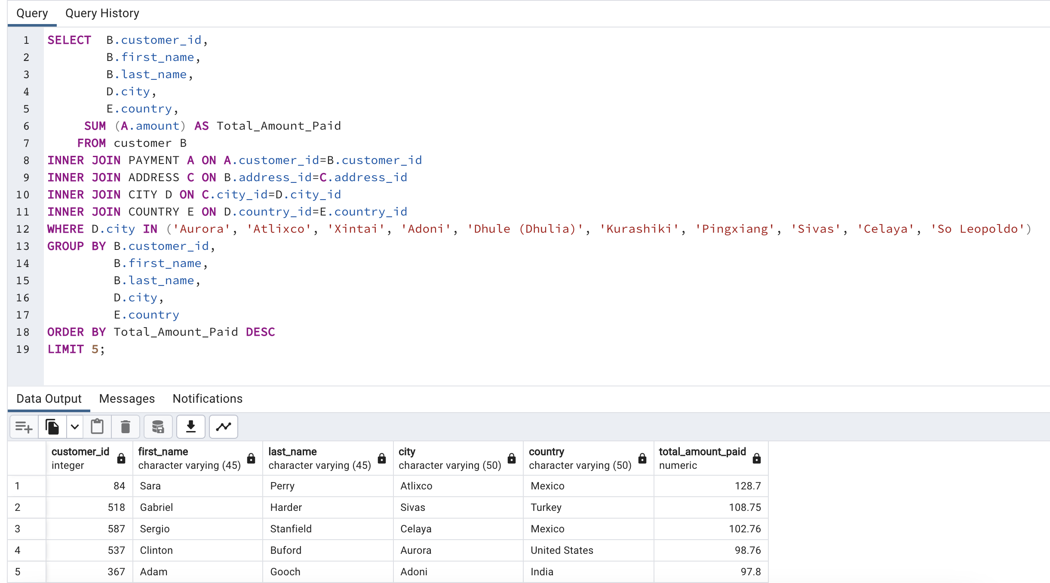
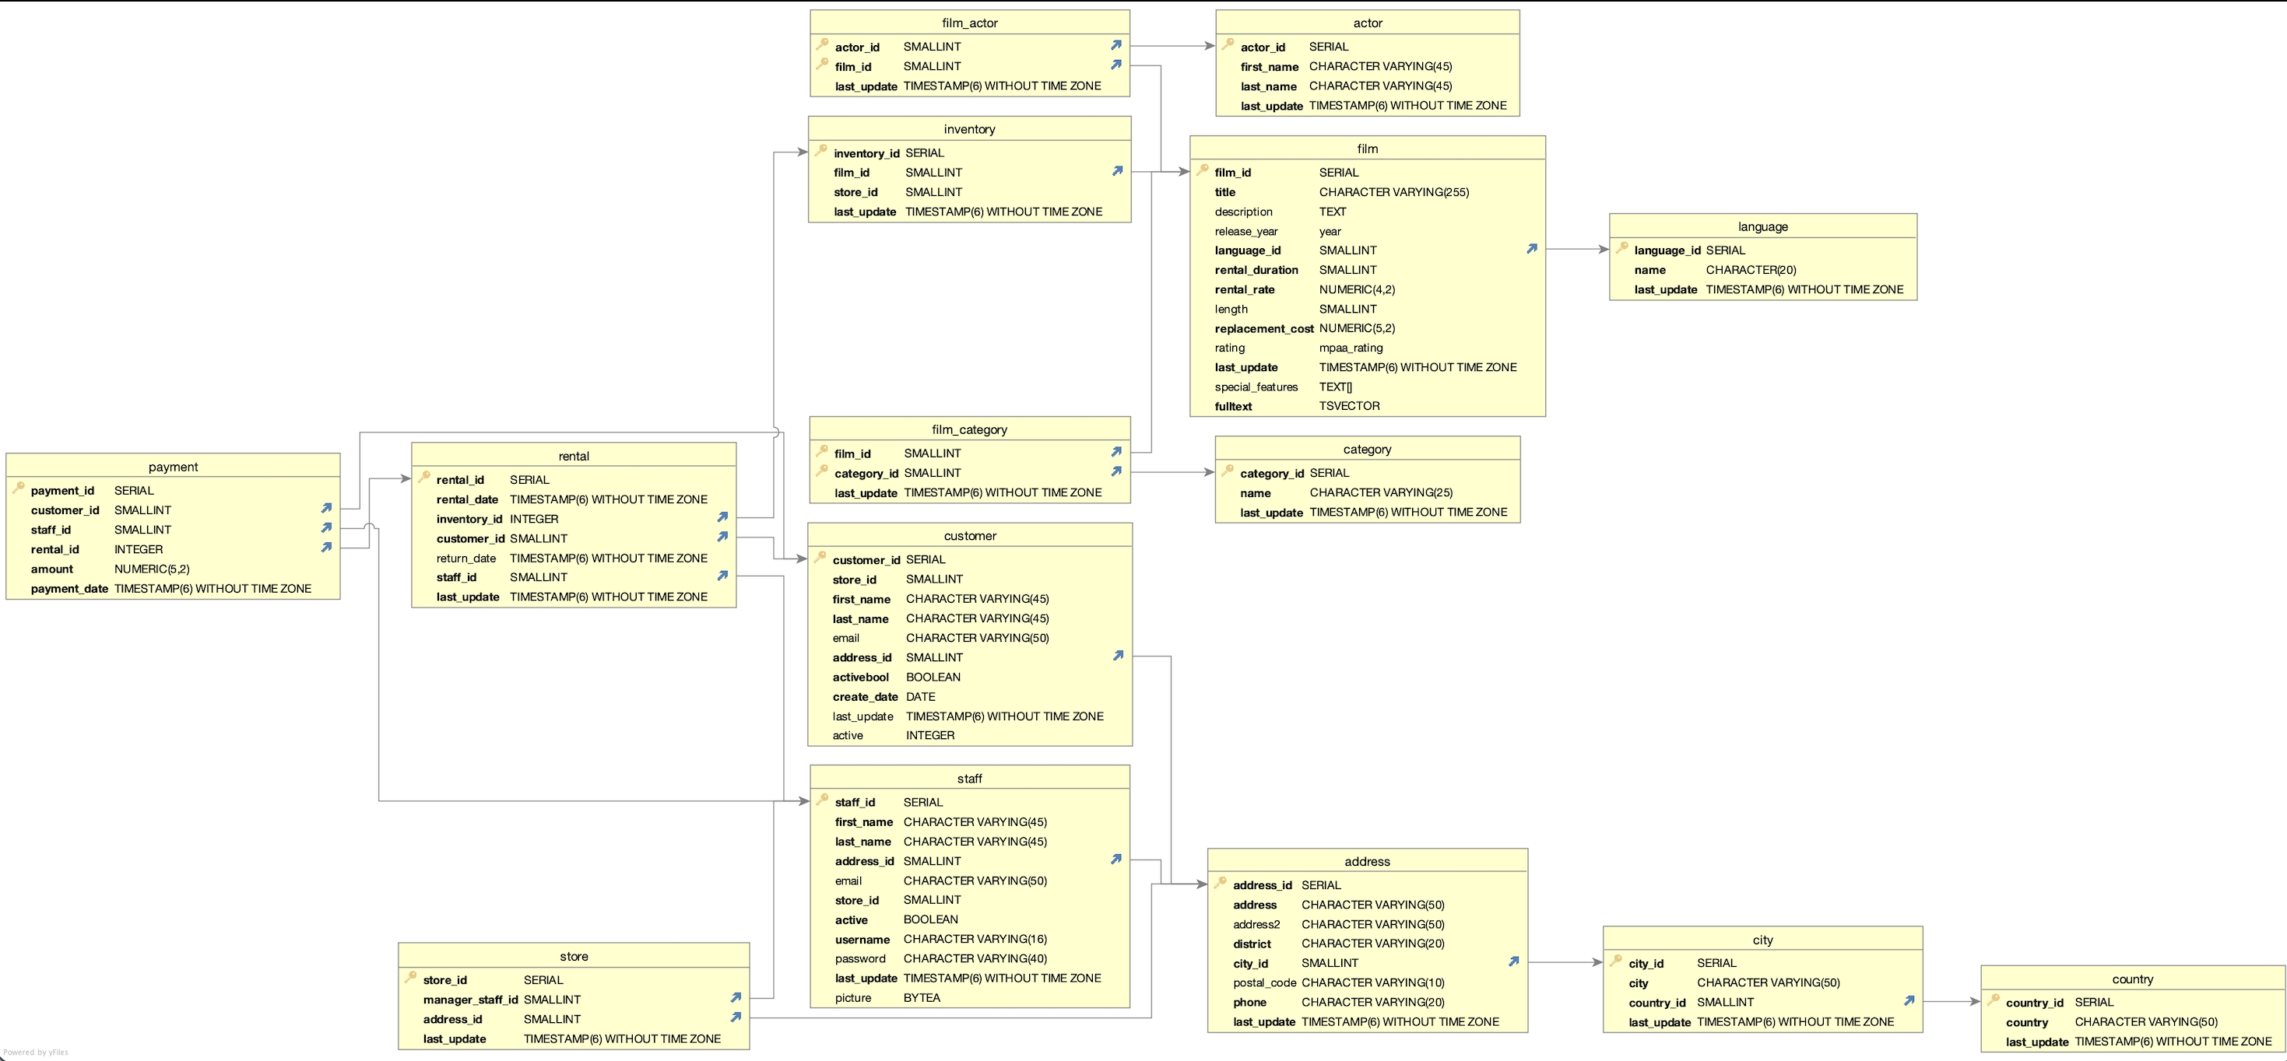
Top Five Countries per Customer Sum India China United States Japan Mexico Brazil
ANALYSIS
Top Five Customers with Highest Purchases in Top Cities
Sara Perry, Mexico
Gabriel Harder, Turkey
Sergio Stanfield, Mexico
Clinton Buford, U.S.
Adam Gooch, India
ROCKBUSTER STEALTH PROJECT

Slide 6

Recommendations
Prioritize the top countries of India, China, US, Japan and Mexico for initiation.
Release Year for all movies was in 2006, diversify the collection.
Prioritize the top genres in Sports, Sci-Fi and Animation for initial release.
Increase the number of Thriller films.
Offer streaming packages (single rental, monthly, unlimited)
ROCKBUSTER STEALTH PROJECT

Slide 7



Thank you

